Slide 1
Blood Bank & Donor Management System
Blood Bank and Donor Management System is a web-based application. The persons who like to donate blood register in the Blood Bank application

Slide 2
Our Team Members
Name :-Sabbir Hossain
ID :-2018100010016
Name :- Md Mostakim Rahman
ID :- 2019000010066
Name :- MD Hasanur Rahman
ID :- 2018100010001

Slide 3
About Blood Bank & Donor Management System
Blood Bank and Donor Management System is a web-based application. The persons who like to donate blood register in the Blood Bank application. The persons in need of blood search for the persons having the same blood group and within the city. If he found a donor in his city then he gets the total details of the donor, if he doesn’t find any donor then he is given the contact numbers and addresses of the Life-Saving Contact Persons for major cities.

Slide 4
Element of this project
Language Used → PHP
DataBase → MySql
User Interface Design → HTML, CSS, JQUERY,JAVASCRIPT
Software → XAMPP
Tested Browser → Mozilla, Google Chrome, IE8, OPERA, Brave
For UI We use Figma

Slide 5
Admin Module
Dashboard: In this section, admin can view all the details in brief like total blood group listed, registered donor list, and total enquiries received.
Blood Group: In this section, admin can manage blood group(Add/ Delete).
Donor List: In this section, admin can view a list of donors and have the right to delete and hide the detail of donor.
Manage Contact us Query: In this section, admin can manage query which is received by users.
Manage Pages: In this section, admin can website pages.
Update Contact info: In this section, admin can update the contact details of the website.
Request Received by Donor: In this section, admin can view the request of blood that is received by the donor.
Admin can also update his profile, change the password and recover the password.

Slide 6
User Module
Home: Its is welcome page for users and donor. If any users want to donate the blood they must register with us.
About Us: Users can view the about us page.
Contact Us: Users can contact with admin the through contact us page.
Donor List: Users can view and contact donors.
Search Donor: Users can search the donor according to city and blood group.

Slide 7
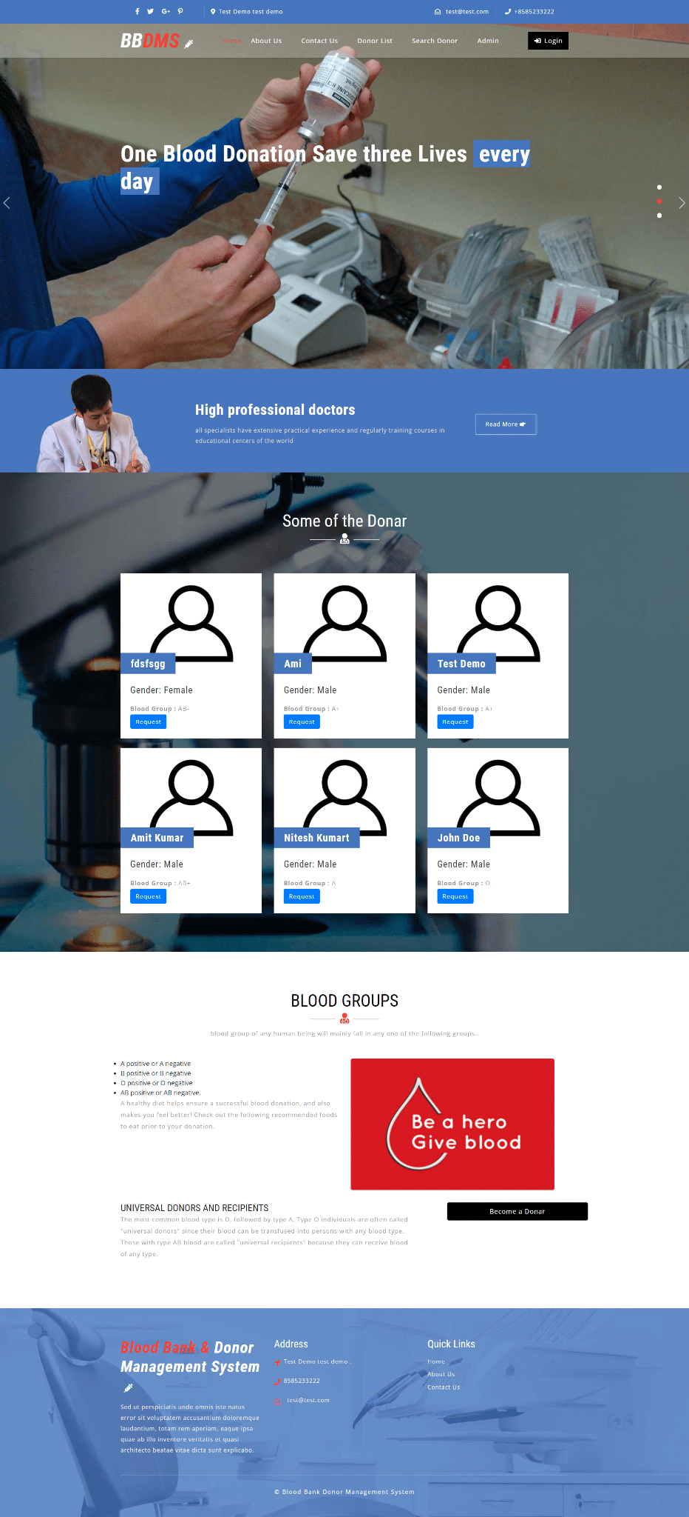
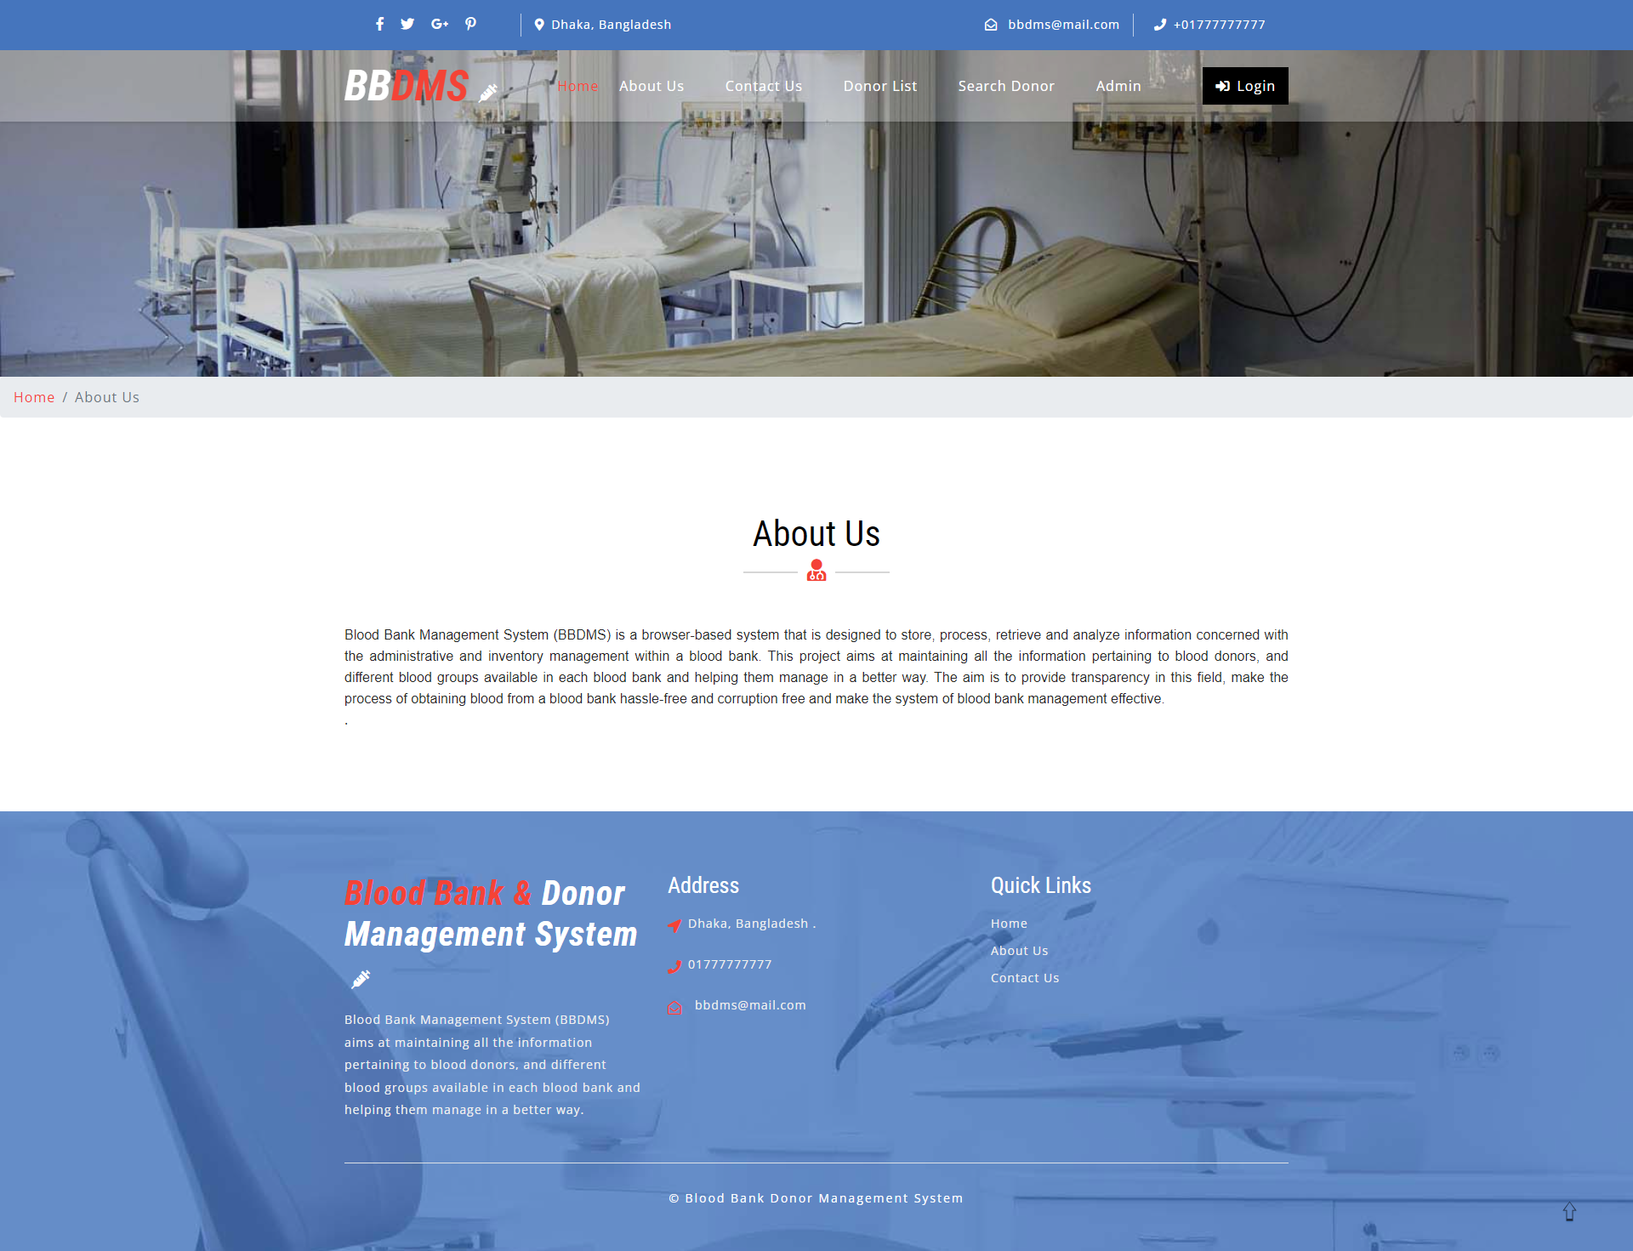
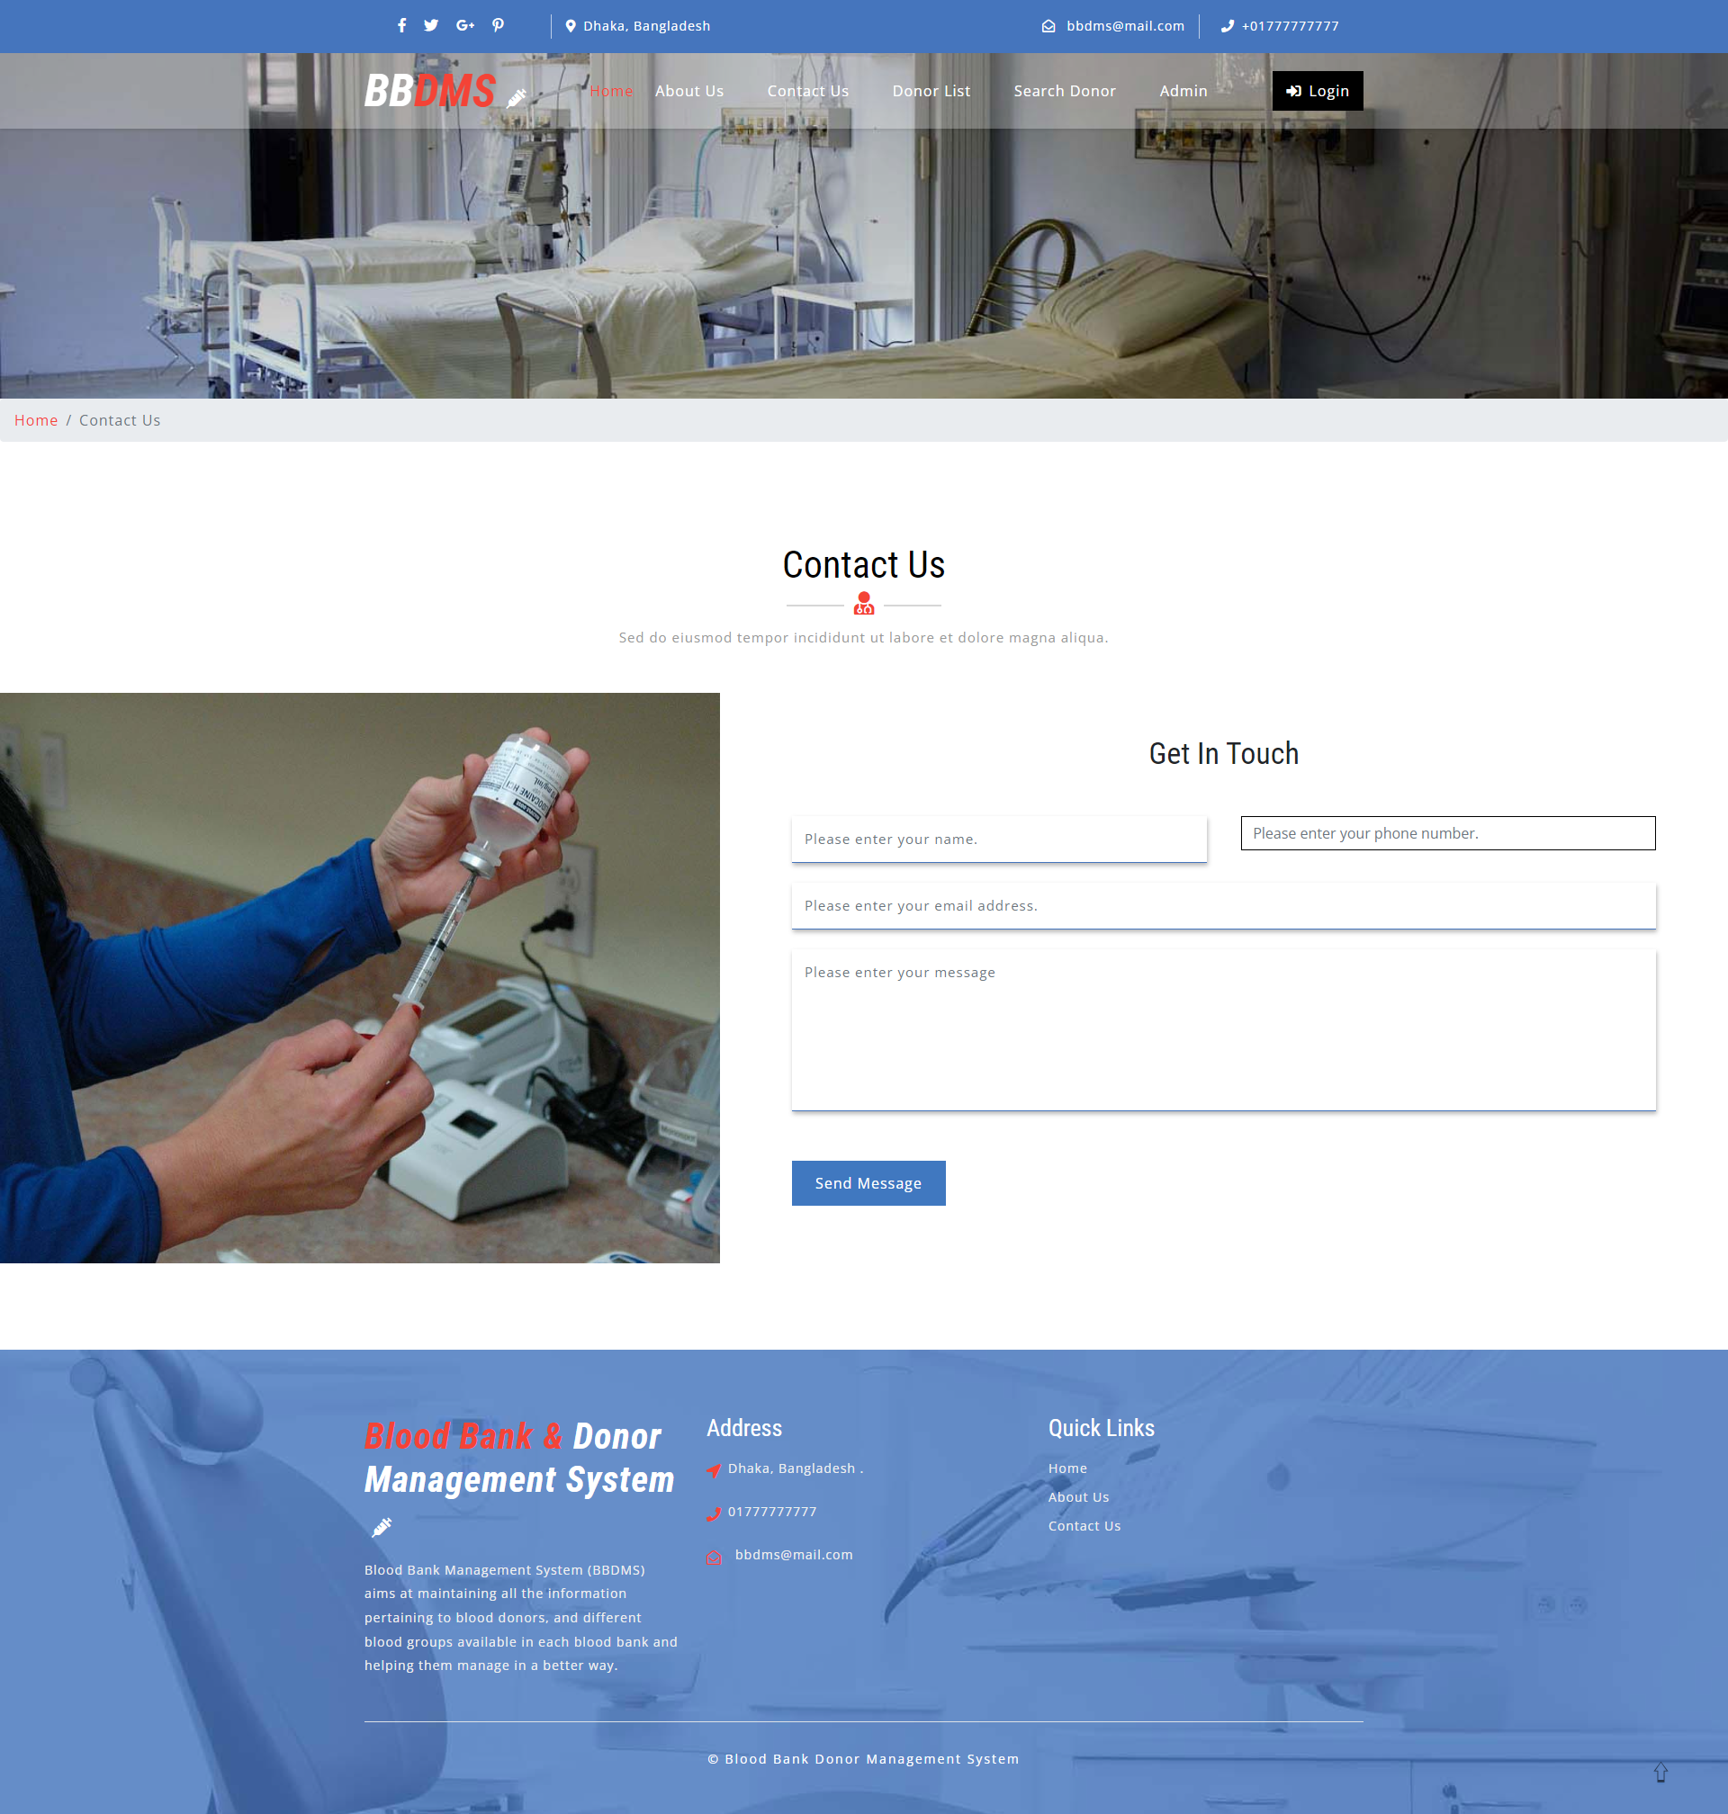
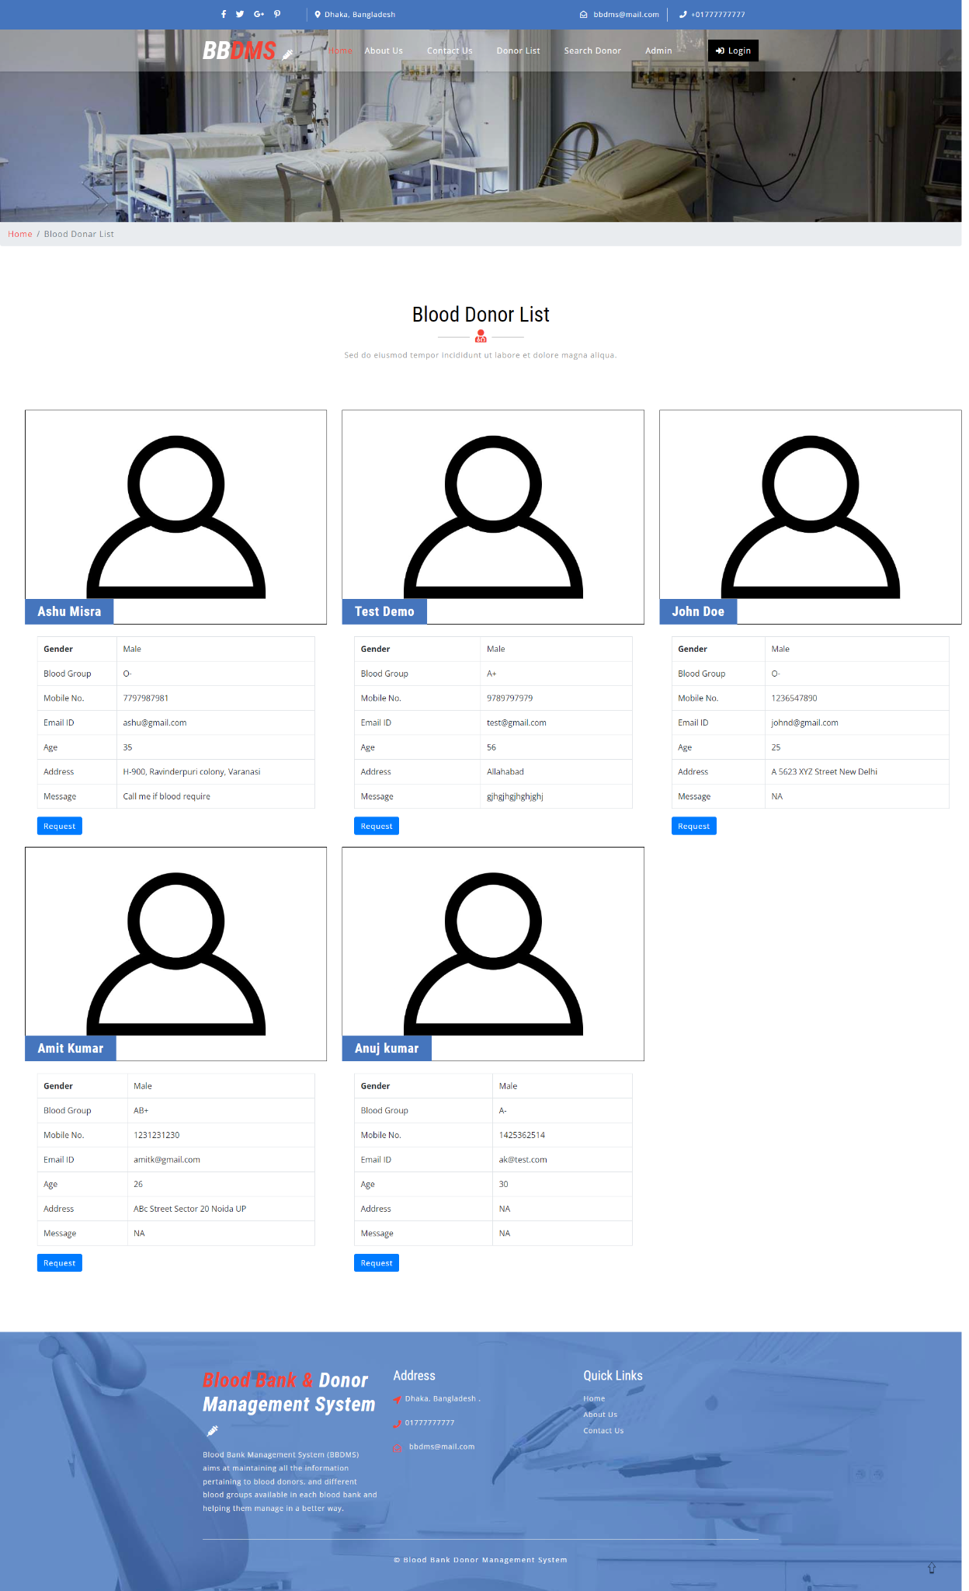
Project Pages

Slide 8
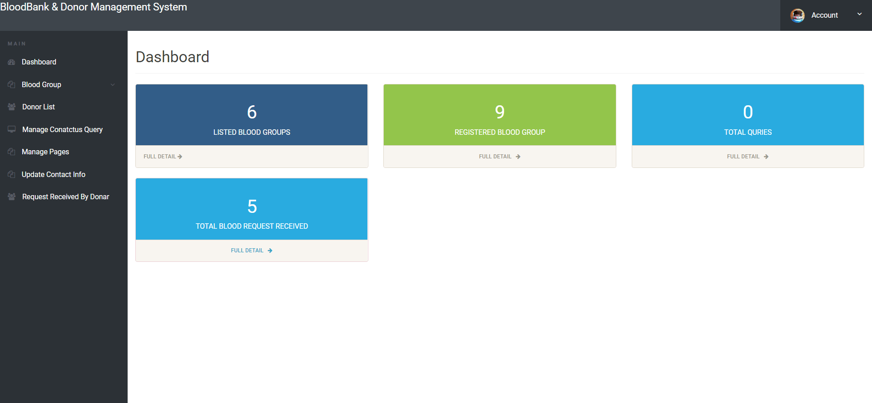
Admin Dashboard

Slide 9
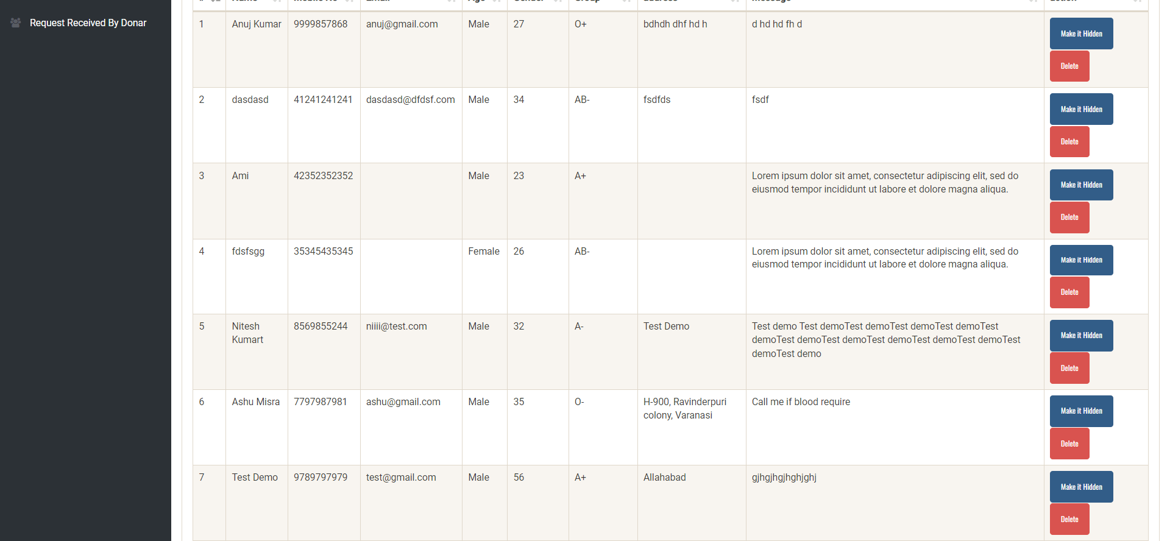
Donor List

Slide 10
That’s all about our project
Thank You

